Slide 1
Dislocations and Strengthening
What is happening during plastic deformation?
Dislocations and Plastic Deformation
  Motion of dislocations in response to stress
  Slip Systems
  Plastic deformation in
    single crystals
    polycrystalline materials
Strengthening mechanisms
  Grain Size Reduction
  Solid Solution Strengthening
  Strain Hardening
Recovery, Recrystallization, and Grain Growth

Slide 2
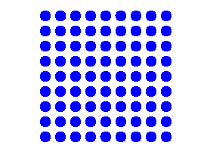
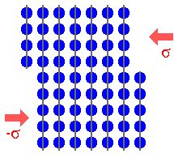
How do metals plastically deform?
Why does forging change properties?
Why deformation occurs at stresses smaller than those for perfect crystals?
Taylor, Orowan and Polyani 1934 :
Plastic deformation due to motion of large number of dislocations.
Plastic deformation under shear stress

Slide 3
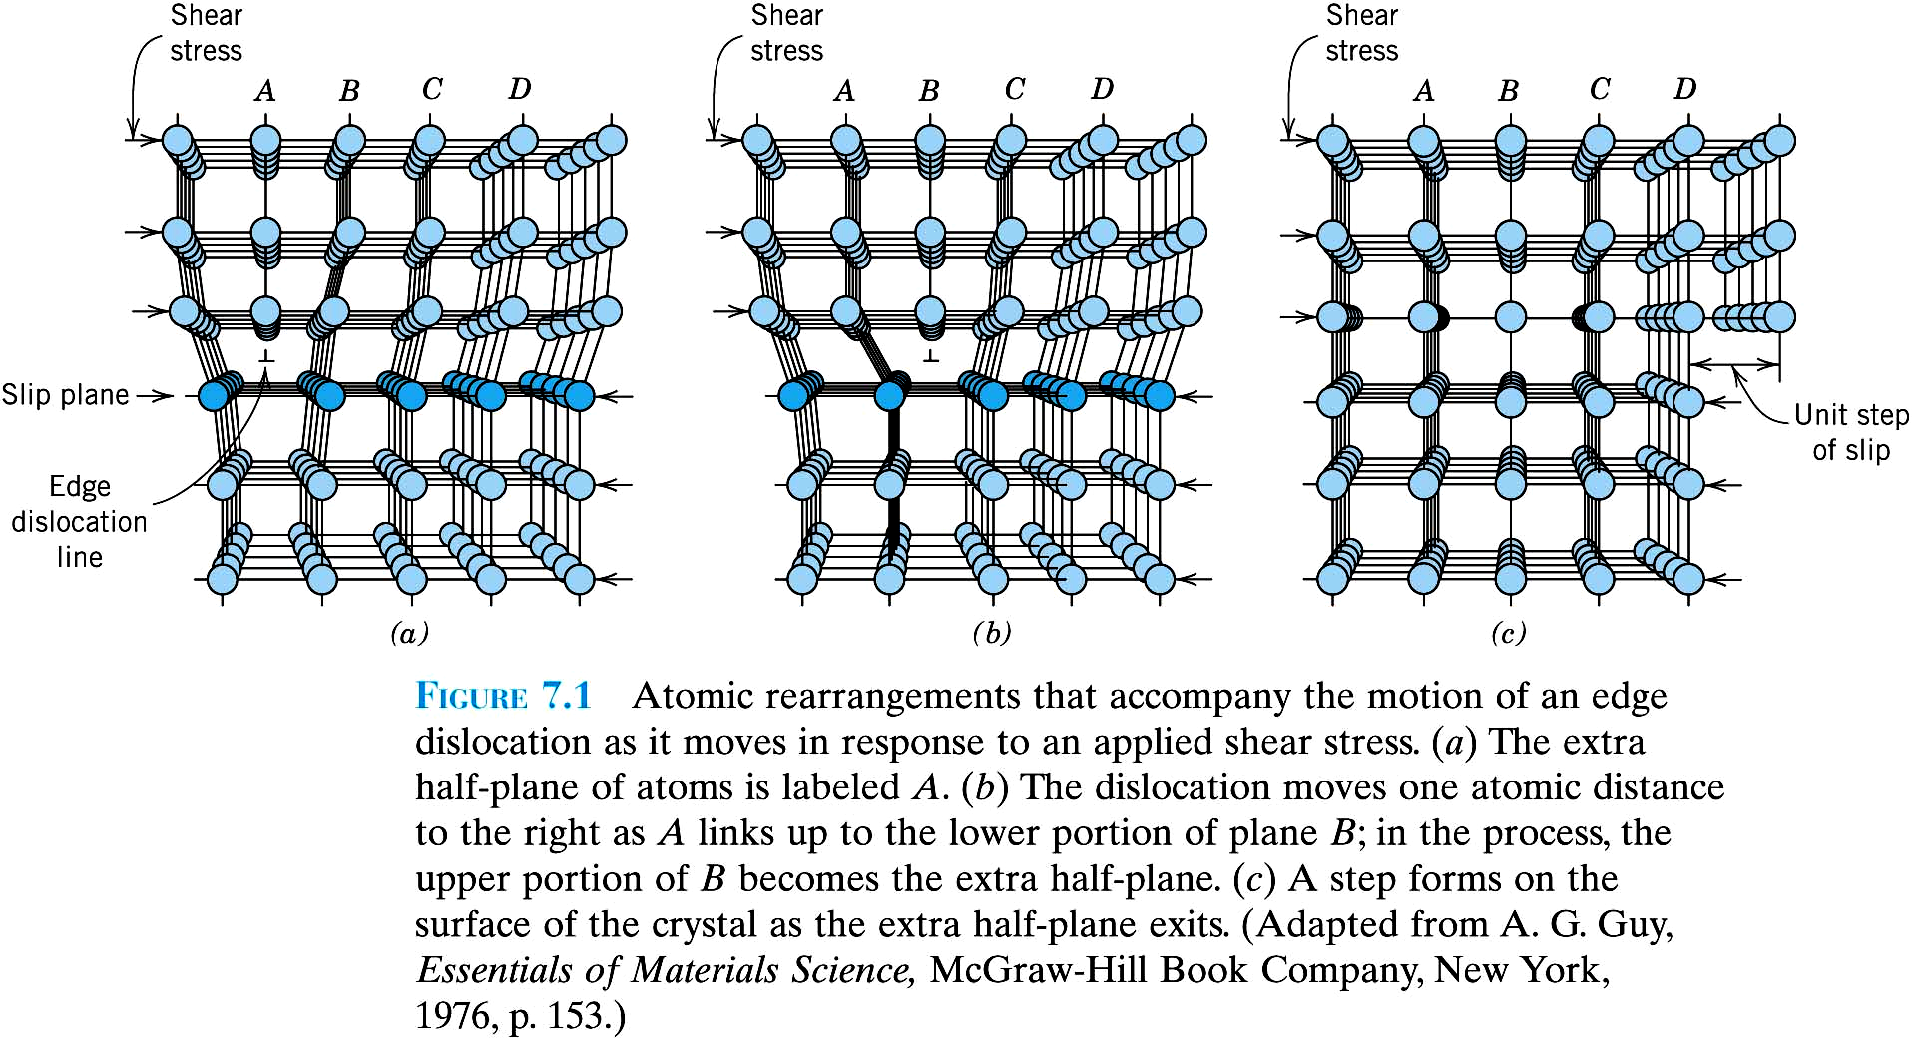

Slide 4
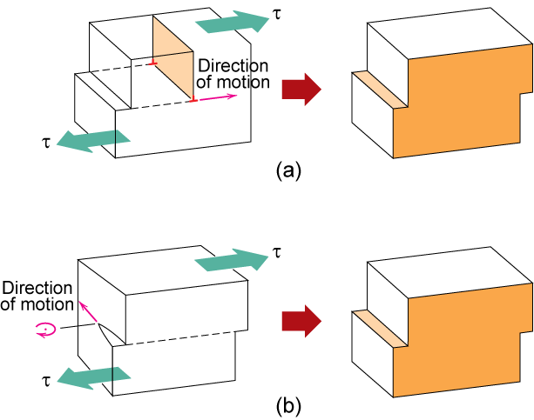
Dislocation moves along slip plane in slip direction perpendicular to dislocation line
Slip direction same direction as Burgers vector
Edge dislocation
Screw dislocation

Slide 5
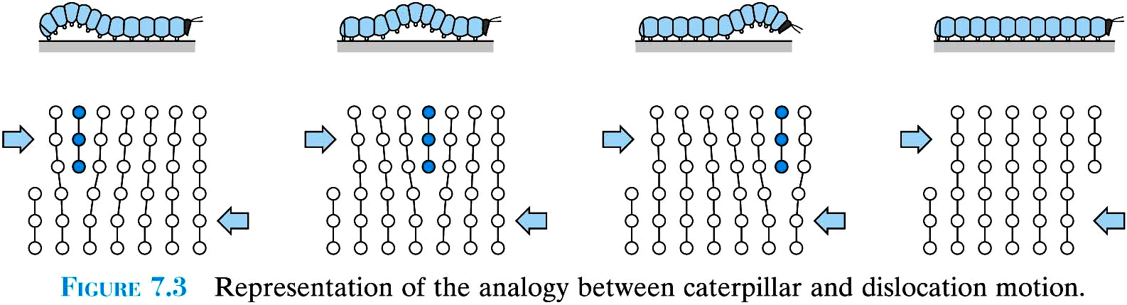
Dislocations allow deformation at much lower stress than in a perfect crystal
Top of crystal slipping one plane at a time.
Only a small of fraction of bonds are broken at any time.
Propagation of dislocation causes top half of crystal to slip with respect to the bottom.
The slip plane – crystallographic plane of dislocation motion.

Slide 6
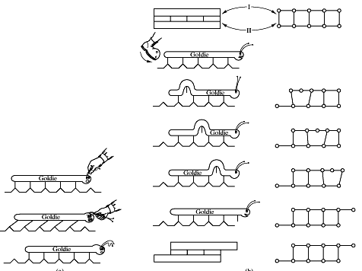

Slide 7
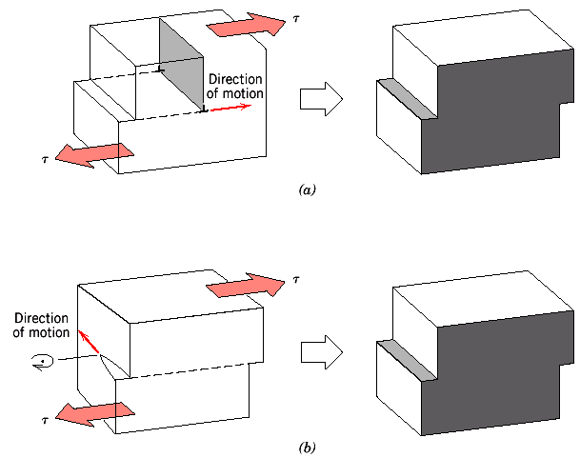
Direction of Dislocation Motion
Edge dislocation line moves parallel to applied stress
Screw dislocation line moves perpendicular to applied stress
Mixed dislocations: direction is in between parallel and perpendicular to applied shear stress

Slide 8
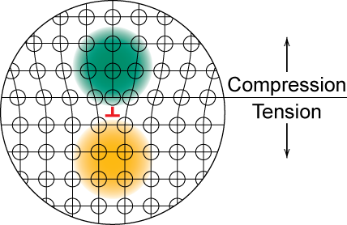
Strain Field around Dislocations
Strain fields from distortions at dislocations: Drops radially with distance.
Edge dislocations → compressive, tensile, and shear lattice
strains.
Screw dislocations → shear strain only.

Slide 9
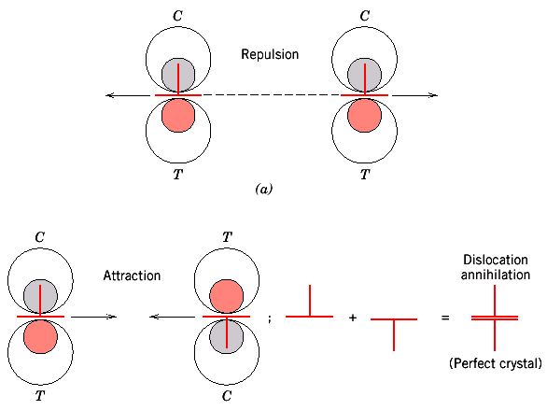
Interactions between Dislocations
Strain fields around dislocations cause them to exert force on each other.
Direction of Burgers vector → Sign
Same signs → Repel
Opposite signs → Attract (annihilate)

Slide 10
Where do Dislocations Come From ?
Dislocation density →
dislocation length/ volume OR number of dislocations intersecting a unit area.
10⁵ cm⁻² in carefully solidified metal crystals to 10¹² cm⁻² in heavily deformed metals.

Slide 11
Most crystalline materials have dislocations due to stresses associated with the forming process.
Number increases during plastic deformation.
Spawn from dislocations, grain boundaries, surfaces.

Slide 12
Slip System
Preferred planes for dislocation movement (slip planes)
Preferred crystallographic directions
(slip directions)
Slip planes + directions (slip systems)
highest packing density.

Slide 13
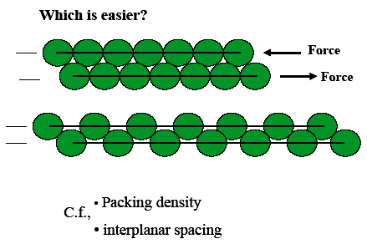
Distance between atoms shorter than average; distance perpendicular to plane longer than average. Far apart planes can slip more easily.
BCC and FCC have more slip systems compared to HCP: more ways for dislocation to propagate ⇒ FCC and BCC are more ductile than HCP.

Slide 14
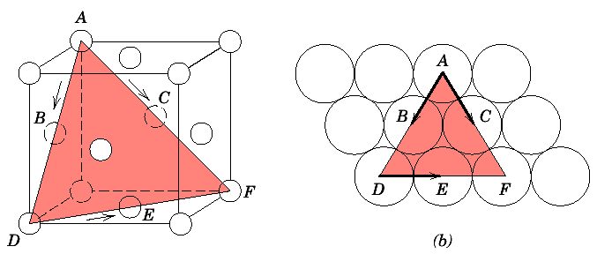

Slide 15
z
z
z
y
y
y
x
x
x
Closed-packed plane
in simple cubic is
{100} => the smallest
shear vector = [100]
Closed-packed plane
in BCC is {110}
=> the smallest shear
vector =1/2[111]
Closed-packed plane
in FCC is {111} =>
The smallest shear
vector = 1/2[110]

Slide 16
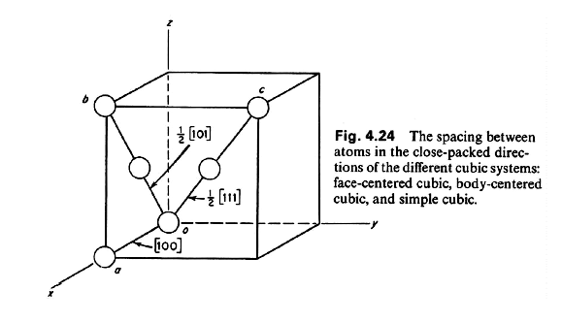

Slide 17



HCP

Slide 18
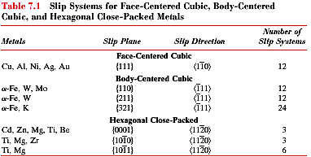

Slide 19
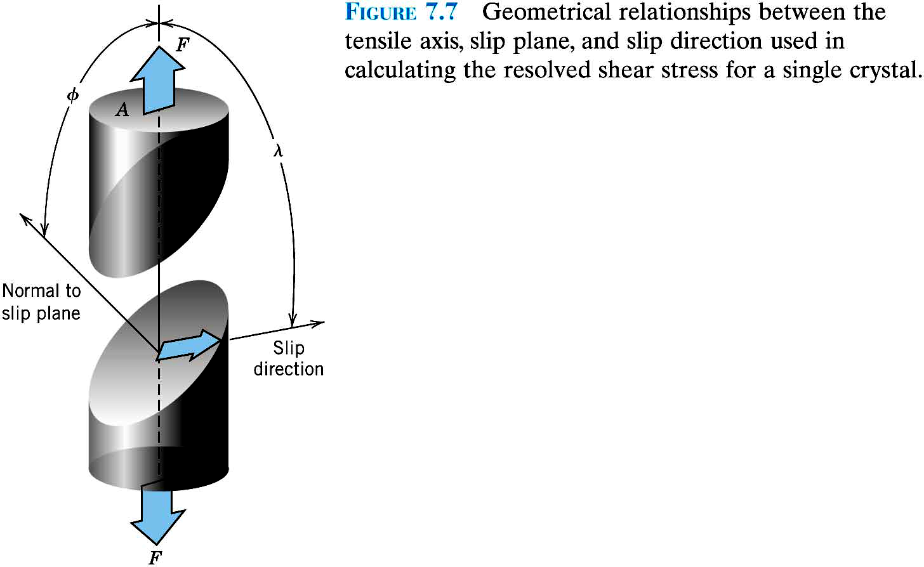
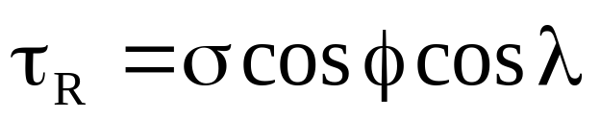
Crystals slip due to a resolved shear stress, τ_{R}.

Slide 20
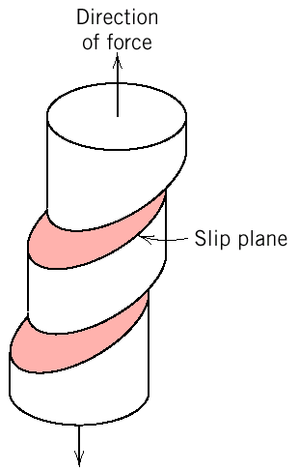
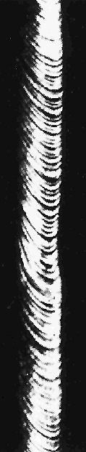
Slip in a Single Crystal
Each step (shear band) results from the generation of a large number of dislocations and their propagation in the slip system
Zn

Slide 21
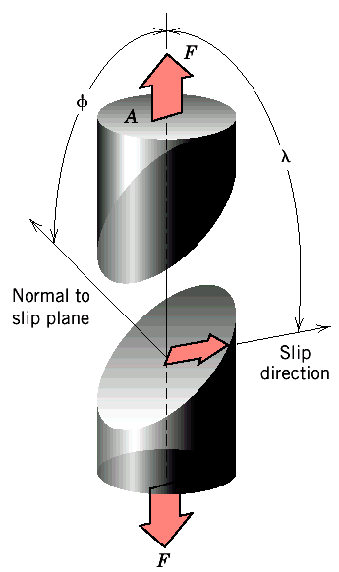
Resolving (Projecting) Applied Stress onto Slip System
Dislocations move along particular planes and directions (the slip system) in response to shear stresses along these planes and directions ⇒ Applied stress is resolved onto slip systems?
Resolved shear stress, τ_{R},
Deformation due to tensile stress, σ.

Slide 22
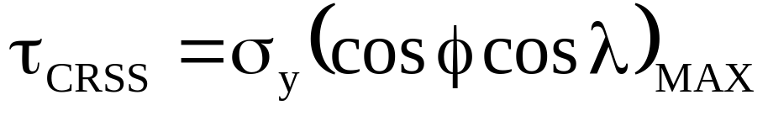
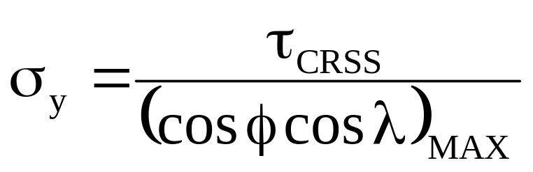
Slip in Single Crystals
Critical Resolved Shear Stress
Resolved shear stress increases → crystal will start to yield (dislocations start to move along most favorably oriented slip system).
Onset of yielding → yield stress, σ_{y} .
Minimum shear stress to initiate slip:
Critical resolved shear stress:

Slide 23
Maximum of (cosφ cosλ)
φ = λ = 45º ⇒ cosφ cosλ = 0.5 ⇒ σ_{y} = 2τ_{CRSS}
Slip occurs first in slip systems oriented close to
(φ = λ = 45º) with respect to the applied stress

Slide 24
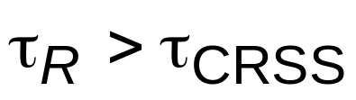

Critical Resolved Shear Stress
• Condition for dislocation motion:
• Crystal orientation can make
it easy or hard to move dislocation
typically
10⁻⁴ GPa to 10⁻² GPa
σ
σ
σ
τ_{R}
= 0
τ_{R}
=
σ
/2
τ_{R}
= 0
λ
=90°
λ
=45°
φ
=90°
φ
=45°
τ maximum at λ = φ = 45º

Slide 25
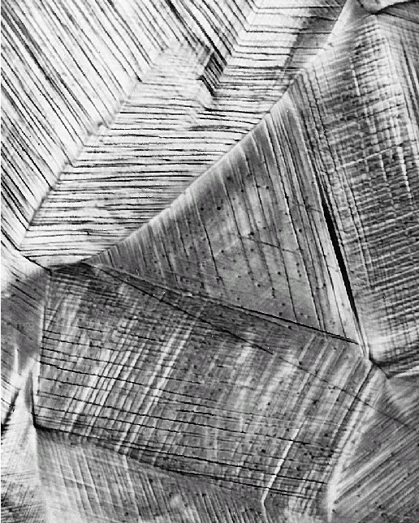
Plastic Deformation of Polycrystalline Materials
Grain orientations with respect to applied stress are typically random.
Dislocation motion occurs along slip systems with favorable orientation
(i.e. highest resolved shear stress).
Cu

Slide 26
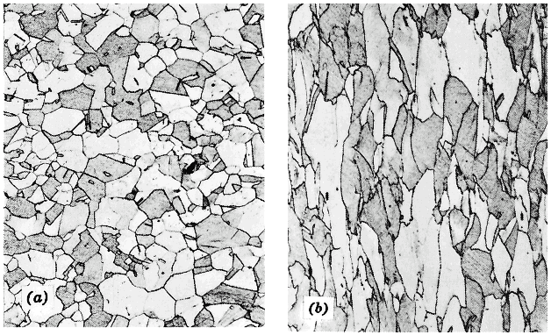
Larger plastic deformation corresponds to elongation of grains along direction of applied stress.
Before After

Slide 27
Polycrystalline metals are typically stronger than single crystals.
Slip directions vary from crystal to crystal ⇒ Some grains are unfavorably oriented with respect to the applied stress (i.e. cosφ cosλ low)
Even those grains for which cosφ cosλ is high may be limited in deformation by adjacent grains which cannot deform so easily
Dislocations cannot easily cross grain boundaries because of changes in direction of slip plane and disorder at grain boundary

Slide 28
Strengthening
The ability of a metal to deform depends on the ability of dislocations to move
Restricting dislocation motion can make material stronger
Mechanisms of strengthening in single-phase metals:
grain-size reduction
solid-solution alloying
strain hardening
Ordinarily, strengthening reduces ductility

Slide 29
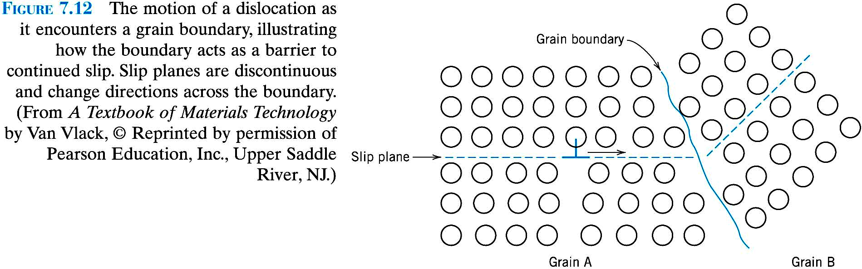
Grain boundaries are barriers to dislocation motion: slip plane discontinues or change orientation.
Small angle grain boundaries are not very effective.
High-angle grain boundaries block slip and increase strength of the material.

Slide 30
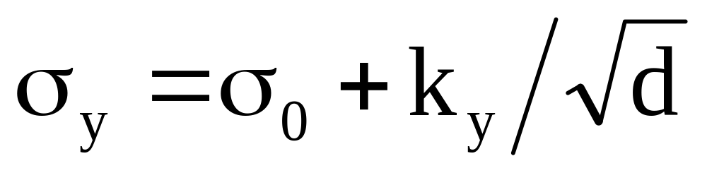
Finer grains → larger area of grain boundaries to impede dislocation motion: also improves toughness.
Hall-Petch equation:
σ_{o} and k_{y} constants for particular material
d is the average grain diameter.

Slide 31
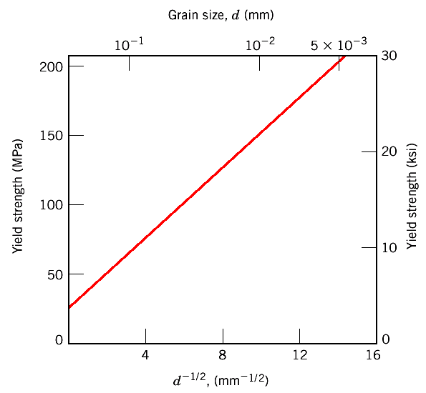
70 Cu - 30 Zn
brass alloy
d determined by rate of solidification, by plastic deformation and by heat treatment.

Slide 32
Alloys usually stronger than pure metals
Interstitial or substitutional impurities cause lattice strain and interact with dislocation strain fields
→ hinder dislocation motion.
Impurities diffuse and segregate around dislocation to find atomic sites more suited to their radii:
Reduces strain energy + anchors dislocation

Slide 33
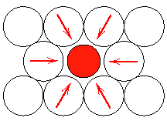
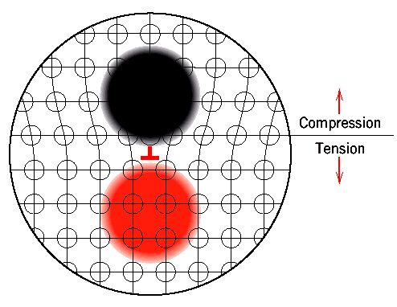
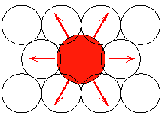
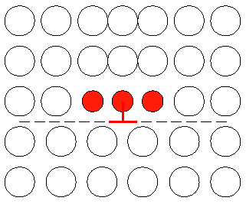
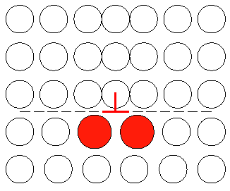
Solid-Solution Strengthening
Smaller and larger substitutional impurities diffuse into strained regions around dislocations leading to partial cancellation of impurity-dislocation lattice strains.

Slide 34
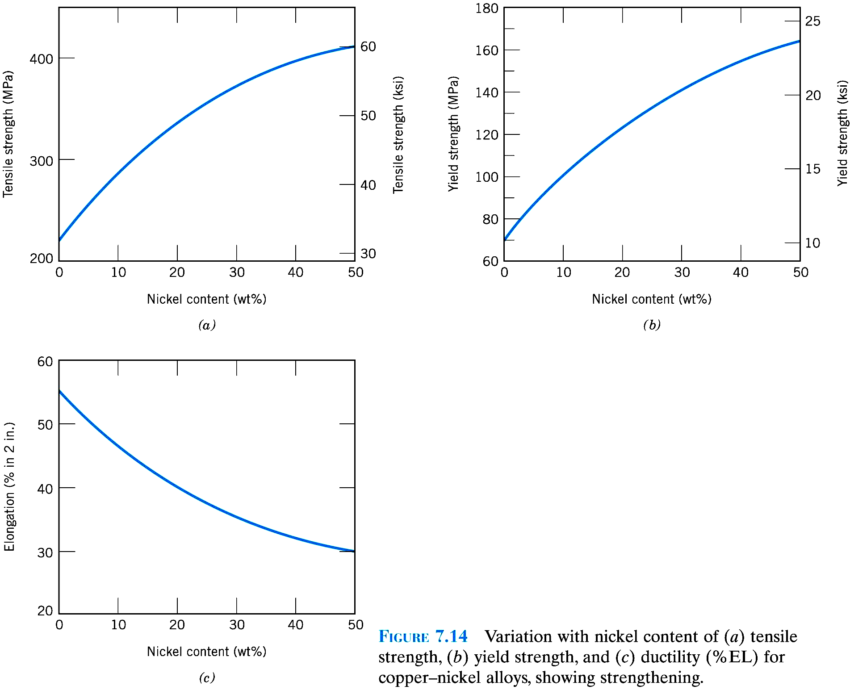

Slide 35
Strengthening by increase of dislocation density
(Strain Hardening = Work Hardening = Cold Working)
Ductile metals strengthen when deformed plastically at temperatures well below melting point.
Reason → increased dislocation density.
Average distance between dislocations decreases; dislocations start blocking each others motion.

Slide 36
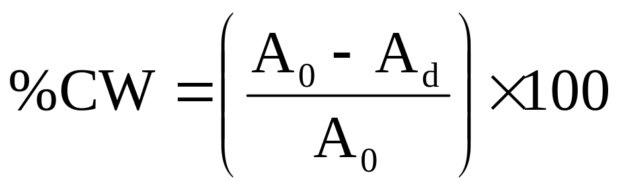
Percent cold work (%CW) →degree of plastic deformation:
where A₀ is the original cross-section area, A_{d} is the area after deformation.
%CW another measure of degree of plastic deformation, like strain.

Slide 37
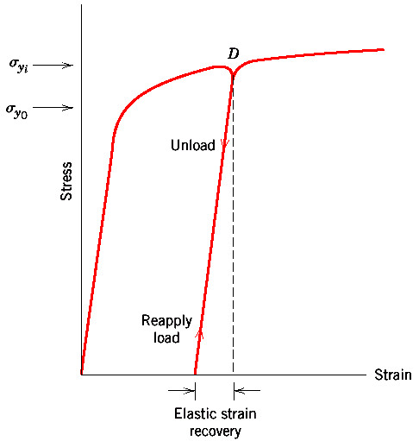
New yield strength σ_{yi} higher than initial yield strength, σ_{y0}.
Reason → strain hardening.

Slide 38
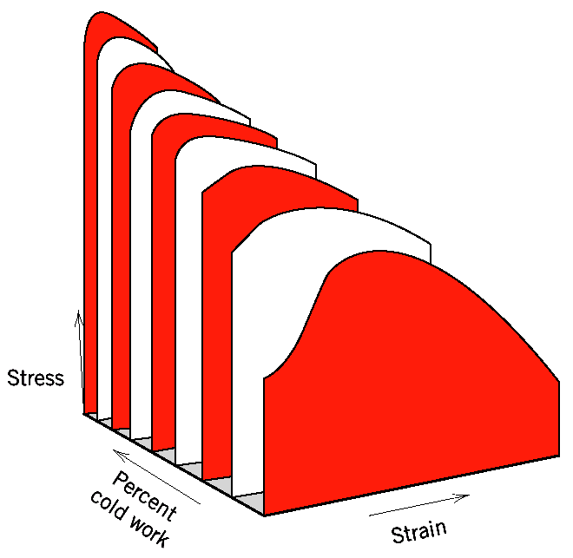
Yield strength + hardness increased due to strain hardening, but ductility decreased (material becomes more brittle).

Slide 39
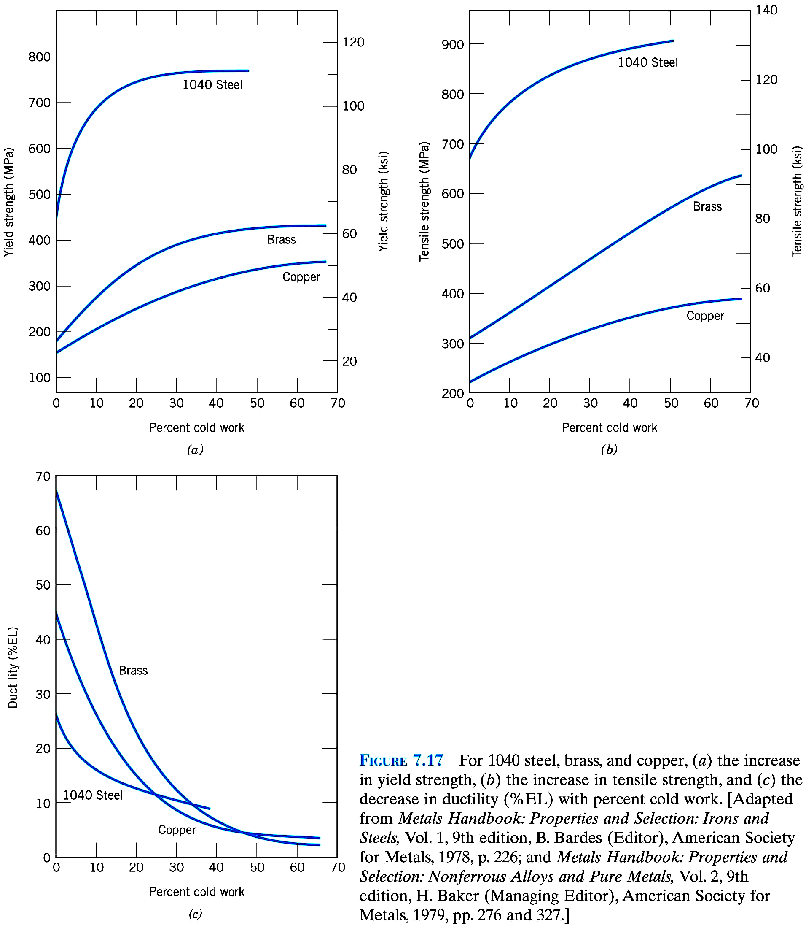

Slide 40
Recovery, Recrystallization, and Grain Growth
Plastic deformation increases dislocation density + changes grain size distribution
Therefore, stored strain energy (dislocation strain fields + grain distortions)
External stress removed: most dislocations, grain distortions and associated strain energy retained.
Restoration to state before cold-work by heat-treatment: →Recovery and Recrystallization,
followed by grain growth.

Slide 41
Recovery
Heating → increased diffusion
→ enhanced dislocation motion
→ decrease in dislocation density by
annihilation, formation of low-energy
dislocation configurations
→ relieves internal strain energy

Slide 42
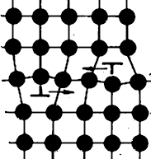
Some of the mechanisms of dislocation annihilation:
Edge dislocation
slip plane

Slide 43
Recrystallization
After recovery grains can still be strained. Strained grains replaced upon heating by strain-free grains with low density of dislocations.
Recrystallization: nucleation and growth of new grains
Driving force: difference in internal energy between strained and unstrained
Grain growth → short-range diffusion
Extent of recrystallization depends on temperature and time.
Recrystallization is slower in alloys

Slide 44
Recrystallization temperature:
temperature at which process is complete in one hour. Typically 1/3 to 1/2 of melting temperature (can be as high as 0.7 T_{m} in some alloys).
Recrystallization temperature decreases as %CW is increased. Below "critical deformation", recrystallization does not occur.

Slide 45
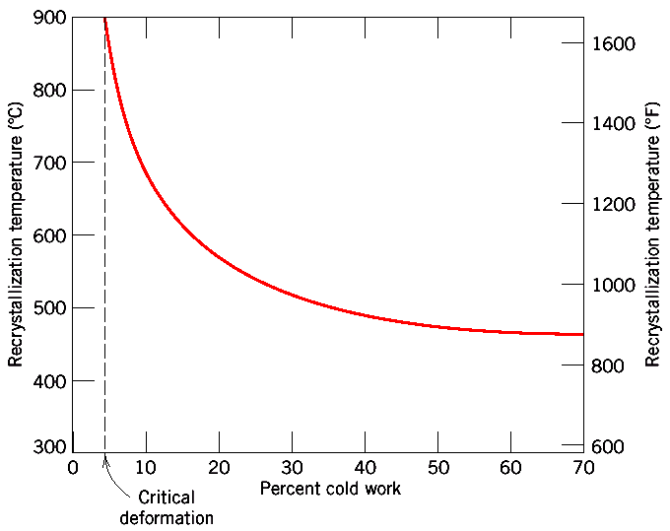

Slide 46
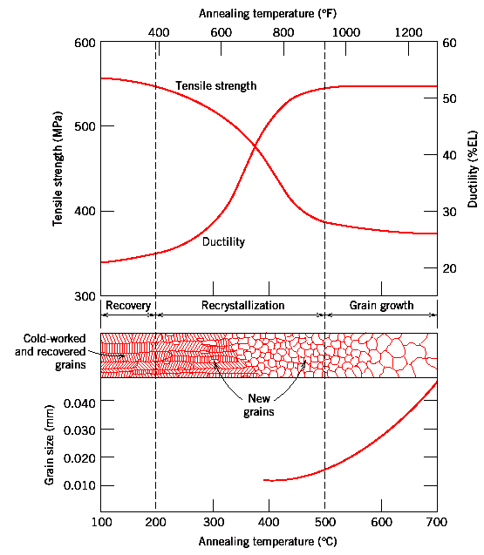

Slide 47
Grain Growth
Deformed polycrystalline material maintained at annealing temperature → following recrystallization further grain growth occurs
Driving force: reduction of grain boundary area and energy:
Big grains grow at the expense of small ones
Grain growth during annealing occurs in all polycrystalline materials
(i.e. they do not have to be deformed first).
Boundary motion occurs by short range diffusion of atoms across the grain boundary → strong temperature dependence of the grain growth.

Slide 48
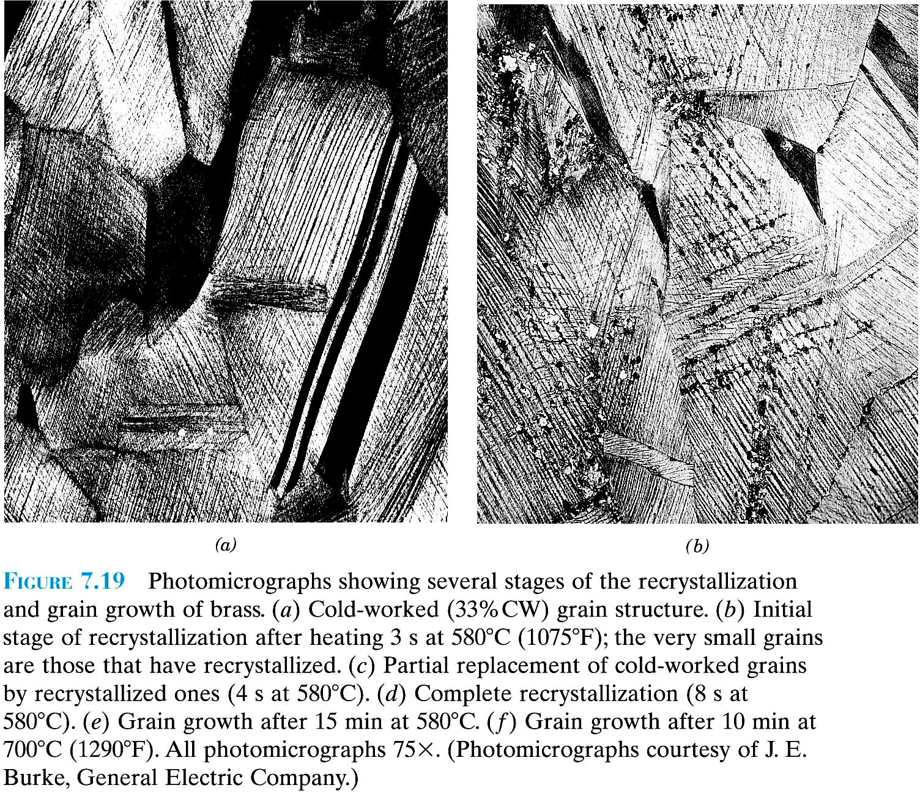
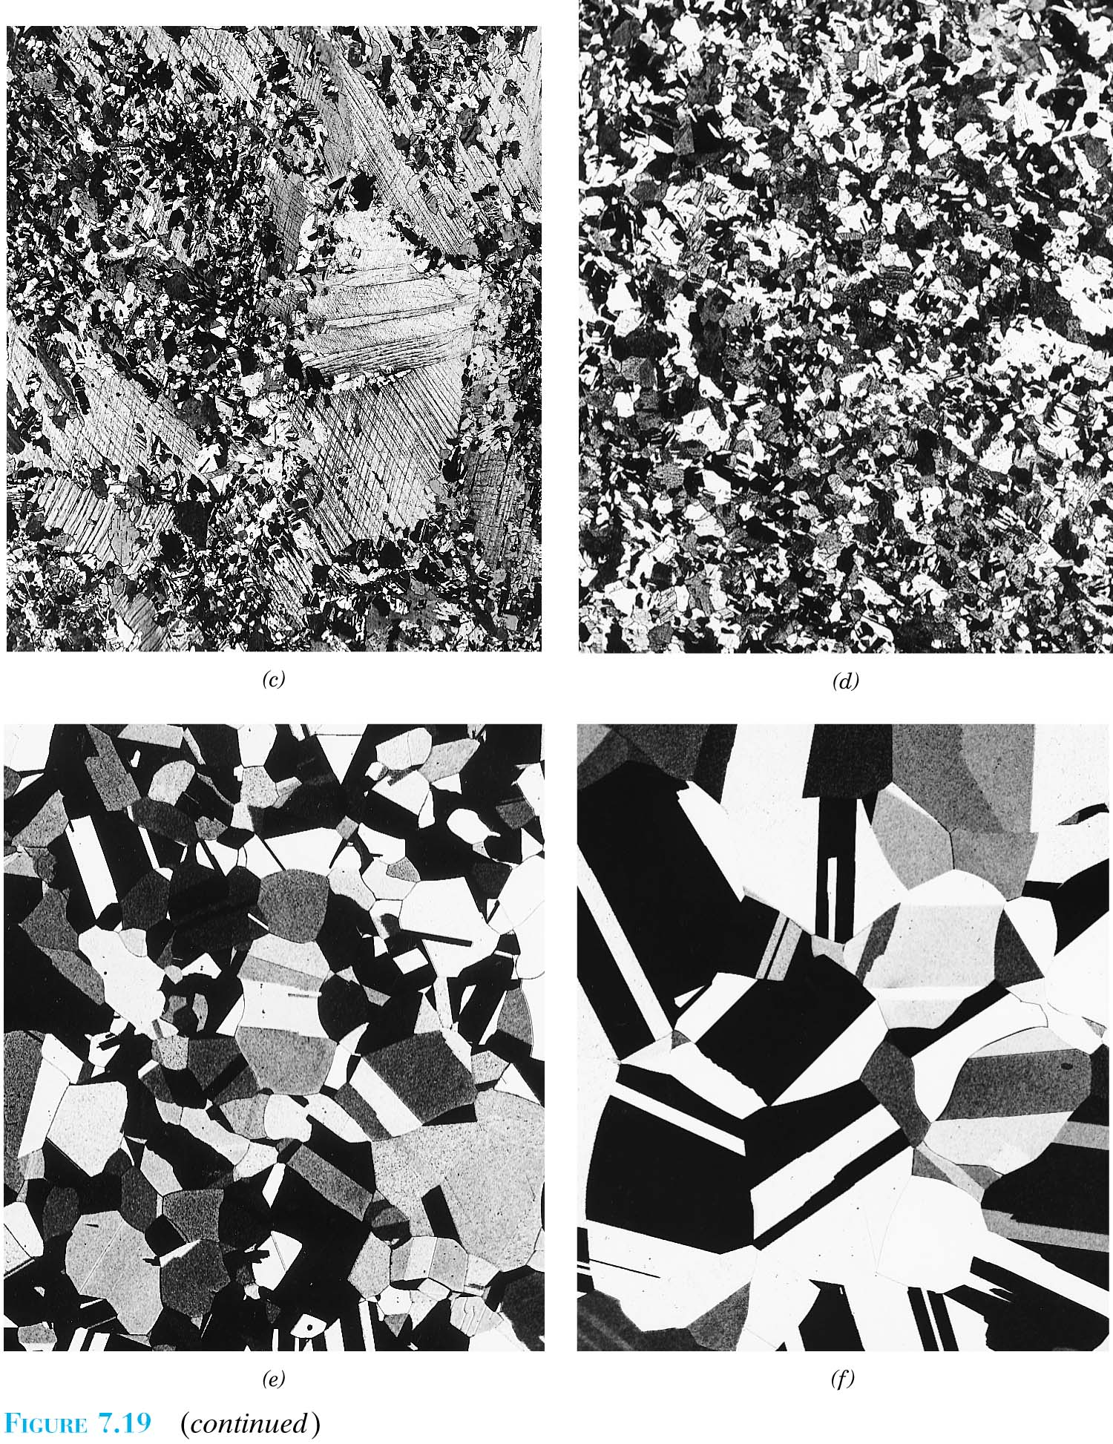

Slide 49
d^{n}-d₀^{n} = Kt
d=grain diameter
d₀=initial grain diameter
K=constant
t= time
n=constant, generally equal to or
greater than 2

Slide 50
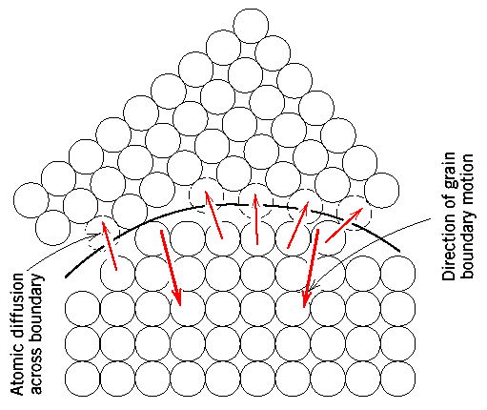

Slide 51
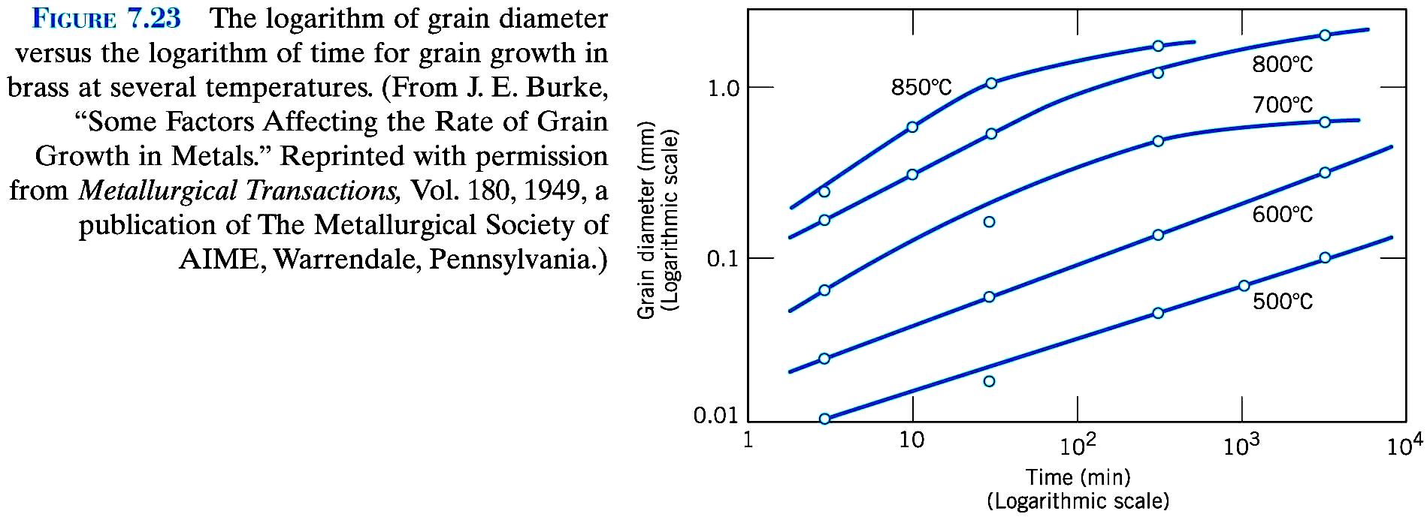

Slide 52
7.13
A single crystal of zinc is oriented for a tensile test such that its slip plane normal makes an angle of 65˚ with the tensile axis. Three possible slip directions make angles of 30˚, 48˚, and 78˚ with the same tensile axis.
(a) Which of these three slip direction is most favored?
(b) If plastic deformation begins at tensile stress of 2.5MPa (355psi), determine the critical resolved shear stress for zinc.

Slide 53
7.17
Consider a single crystal of some hypothetical metal that has the BCC crystal structure and is oriented such that a tensile stress is applied along a [121] direction. If slip occurs on a (101) plane and in [ī11] direction, compute the stress at which the crystal yields if its critical resolved shear stress is 2.4 MPa.

Slide 54
7.24
The lower yield point for an iron that has an average grain diameter of 1×10⁻² mm is 230MPa (330psi). At a grain diameter the grain size of 6×10⁻³mm, the yield point increases to 275MPa (40,000psi). At what grain diameter will the lower yield point be 310 MPa (45,000)?

Slide 55
7.38
The average grain diameter for a brass material was measured as a function of time at 650℃, which is tabulated below at two different times:
Time (min) Grain Diameter (mm)
40 5.6×10⁻²
100 8.0×10⁻²
(a) What was the original grain diameter?
(b) What grain diameter would you predict after 200min at 650℃?

